Slide 1
Centralized Backup & Recovery Server
LINUX SYSTEM ADMINISTRATION
A Linux backup server with full, incremental and scheduled backups, plus recovery testing.
Shell scripts
Cron jobs
Recovery demo
Logs
Notes:
Introduce the project: a centralized backup and recovery server built on Linux with shell scripts, cron and a Tkinter dashboard.

Slide 2
Protect data, and prove it can be recovered
OBJECTIVE
The problem
The goal
The approach
Files get deleted, corrupted or lost to hardware failure, and manual copies are inconsistent and untested.
One central Linux server that automates backups, keeps them in one place and verifies that recovery works.
Shell scripts for each task, cron for scheduling, and a Tkinter dashboard that runs everything from one menu.
Notes:
State the problem, the goal and the approach in one pass. Keep it short; details follow on later slides.

Slide 3




What the project delivers
DELIVERABLES
Backup scripts
Cron jobs
Recovery demo
Logs
Ten shell scripts: full and incremental backup, restore, checksum and recovery tests.
Scheduled incremental backups, managed from a cron job menu.
Restore to a chosen folder and run a recovery test on demand.
backup.log and cron.log record every run and every scheduled job.
Notes:
These four items are the required deliverables for the microproject: scripts, cron jobs, recovery demonstration and logs.

Slide 4
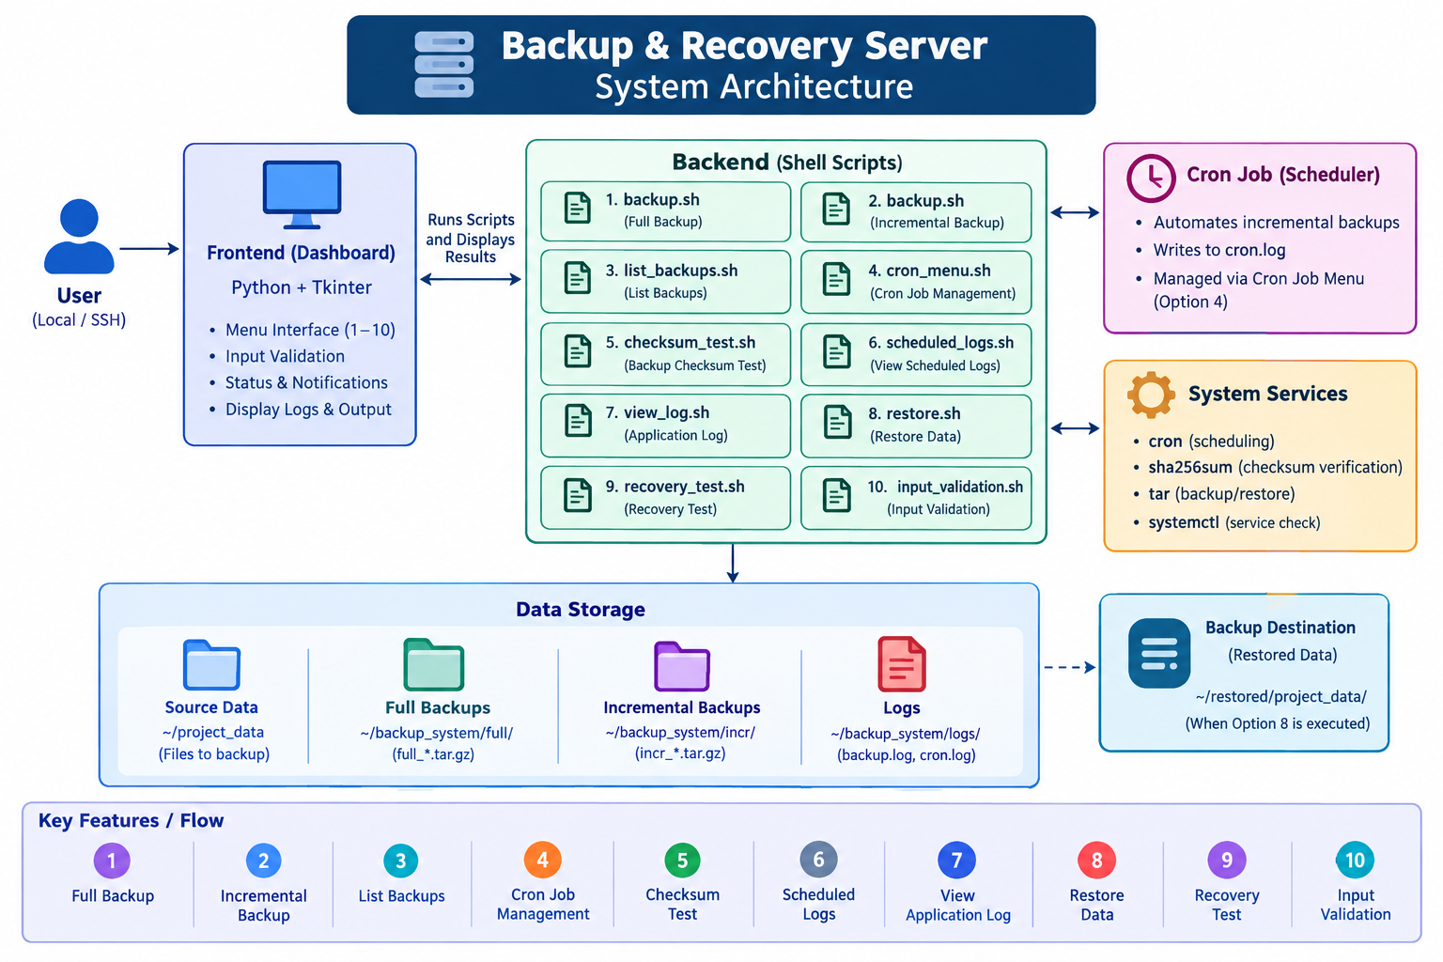
System architecture
ARCHITECTURE
Dashboard takes the menu choice and shows the results.
Scripts do the work, one script per menu option.
Storage keeps source data, full and incremental backups, and logs.
Notes:
Walk through the diagram left to right: the user works through the dashboard, which runs the backend scripts. Cron and system services support the scripts, and everything lands in the storage folders.

Slide 5
Five parts, one workflow
COMPONENTS
Component | Technology | Role
Dashboard | Python + Tkinter | Menu 1–10, input validation, status and log display
Backend | Shell scripts | One script per menu option, run by the dashboard
Scheduler | cron | Runs incremental backups automatically, writes cron.log
System services | tar, sha256sum, systemctl | Backup and restore, checksum checks, service check
Storage | Folders on disk | Source data, full and incremental backups, logs
Notes:
Each component has one job. The dashboard never does backup work itself; it calls the scripts and shows what they print.

Slide 6
Where everything lives
DATA STORAGE
Folder | Path | Contents
Source data | ~/project_data | Files to back up
Full backups | ~/backup_system/full/ | full_*.tar.gz
Incremental | ~/backup_system/incr/ | incr_*.tar.gz
Logs | ~/backup_system/logs/ | backup.log, cron.log
Restored data | ~/restored/project_data/ | Output of Restore Data (option 8)
Notes:
Backups are compressed tar archives, so each one is a single file that can be listed, checksummed and restored.

Slide 7
Full and incremental backups
BACKUP TYPES
Option 1
Option 2
Full backup
Incremental backup
Archives all of the source data into one full_*.tar.gz file
A complete copy, simplest to restore
Larger and slower than an incremental run
Archives only what changed since the previous backup into incr_*.tar.gz
Smaller and faster, saves disk space
The type that cron runs automatically
Notes:
Both are driven by backup.sh. Full backups are the baseline; incremental backups keep the archive current without copying everything again.

Slide 8

Automated backups with cron
SCHEDULING
01
02
03
Cron triggers
Backup runs
Result is logged
The scheduler fires the job at its set time with no one present.
An incremental backup is saved to the incr folder.
The run is written to cron.log for later review.
Option 4 manages cron jobs. Option 6 shows the scheduled logs.
Notes:
Scheduling removes the human step: incremental backups happen on their own and every run leaves a log entry.

Slide 9
Verify, restore, test
RECOVERY
Option 5
Option 8
Option 9
Checksum test
Restore data
Recovery test
Uses sha256sum to confirm a backup archive has not been corrupted.
restore.sh extracts a backup into the destination chosen on the dashboard.
recovery_test.sh demonstrates that a backup can really be recovered.
A backup only counts once recovery has been shown to work.
Notes:
This is the recovery demonstration deliverable. Show checksum first, then restore, then the recovery test, ideally live from the dashboard.

Slide 10
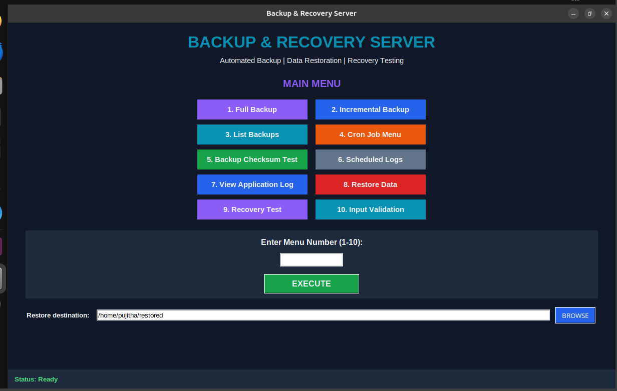
The Tkinter dashboard
DASHBOARD
Pick a task by clicking a button or typing 1–10, then Execute.
Choose where to restore with the destination field and Browse.
Follow progress in the status bar at the bottom.
Notes:
Switch to a live demo here if possible: run a full backup, then an incremental one, then list the backups.

Slide 11
Ten options, ten scripts
MENU
# | Option | Script
1 | Full Backup | backup.sh
2 | Incremental Backup | backup.sh
3 | List Backups | list_backups.sh
4 | Cron Job Menu | cron_menu.sh
5 | Backup Checksum Test | checksum_test.sh
# | Option | Script
6 | Scheduled Logs | scheduled_logs.sh
7 | View Application Log | view_log.sh
8 | Restore Data | restore.sh
9 | Recovery Test | recovery_test.sh
10 | Input Validation | input_validation.sh
Notes:
Every dashboard button maps to exactly one backend script, which keeps the design simple to test and extend.

Slide 12
Every action leaves a record
LOGS AND VALIDATION
backup.log
cron.log
Input validation
The application log for backup and restore runs. Open it with option 7.
Records each scheduled run. Open it with option 6.
Menu input is checked before anything runs (option 10).
Notes:
Logs make the system auditable: you can always see what ran, when, and whether it worked.

Slide 13
Outcomes and next steps
CONCLUSION
What was achieved
Possible next steps
Full and incremental backups from one dashboard
Scheduled backups through cron
Integrity checks with sha256sum
Restore and recovery test demonstrated
Logs for every backup and scheduled run
Off-site or remote copies
Email alerts on failure
Automatic cleanup of old backups
Notes:
Close by tying the outcomes back to the four deliverables: scripts, cron jobs, recovery demonstration and logs. The next steps are ideas for extension, not part of the current build.

Slide 14
Thank you
CENTRALIZED BACKUP & RECOVERY SERVER
Notes:
Invite questions and offer to run the dashboard live.

